Slide 1
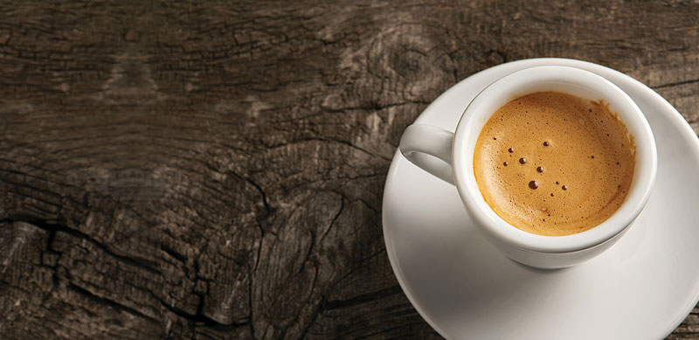
Finding the best location for a coffee shop/cafe in NYC
Capstone Project - The Battle of Neighborhoods

Slide 2
Introduction/Business Problem
When starting a business for the first time, it can be daunting to identify the best location.
Suppose a new entrepreneur wants to open a coffee shop or a cafe in New York City (Manhattan). Which neighborhood would be the best location to open up his/her shop?

Slide 3
Data and Methodology
Assumption:
The neighborhood(s) with the highest number of coffee shops and cafes has the highest demand for caffeinated drinks, and therefore, that neighborhood would be the best location to open up the business.
Approach:
Use the dataset from NYU containing the geographic locations of the NYC neighborhoods and Foursquare API call to retrieve all venues within the radius of 500 meters of each neighborhood.
Once the list of venues are retrieved, filter down to only the venues that were categorized as a coffee shop or a cafe.
Create a frequency table of coffee shops and cafes for each NYC neighborhood.
Give “top choice” label to the neighborhoods with the highest number of coffee shops and cafes, "second choice“ to those with the second highest number of venues, and "third choice“ to those with the third highest number.

Slide 4
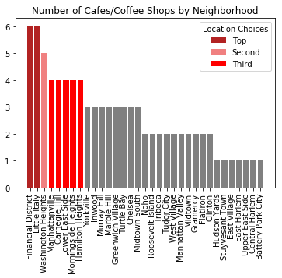
Results
The bar plot shows how many coffee shops and cafes were located within the radius of 500 meters for each NYC neighborhood, sorted in a descending order.
The top choice neighborhoods are denoted in "FireBrick" color. The second choice neighborhood is denoted in "Light Coral" color, and the third choice neighborhoods are denoted in "Red" color. The rest of the neighborhoods are denoted in "Gray" color.

Slide 5
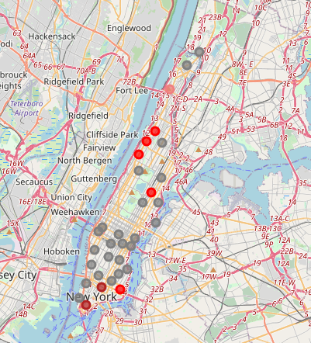
Results (continued)
To better make sense of where these neighborhoods are located in NYC, the results are plotted on a map.
Colors of the circles corresponds to those used in the bar plot.

Slide 6
Recommendation
The results indicate that the top location choices for a new coffee shop or a cafe are Financial District and Little Italy, which are both located near the bottom tip of Manhattan.
Also, the neighborhoods to the northwest of Central Park have relatively high demand for caffeinated drinks, and therefore, those neighborhoods could also be potentially good locations for the new entrepreneur to open up his/her business.

